Slide 1
Cairo Graphics Kit (a.k.a CGK) ESUG 2011
Chris Thorgrimsson
08/24/2011
Copyright Lam Research Corporation

Slide 2
Background
Who am I ?
Chris Thorgrimsson
Senior Staff Software Engineer
Lam Research Corporation
chris.thorgrimsson@lamrc.com
What does Lam Research do?
Major supplier of wafer fabrication equipment and services to the worldwide semiconductor industry
IC components inside cell phones, computers, tablets…etc are manufactured using our equipment
VisualWorks Smalltalk is at the heart of our equipment control system

Slide 3
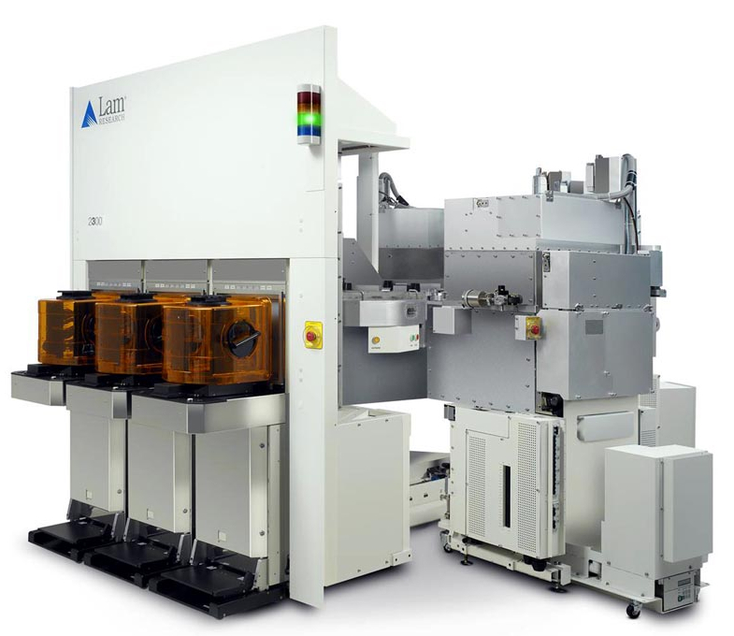
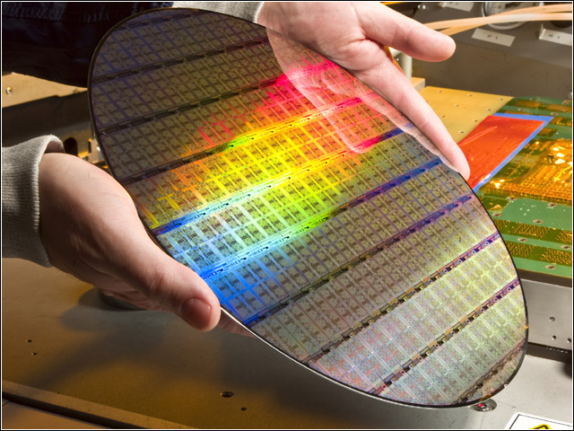
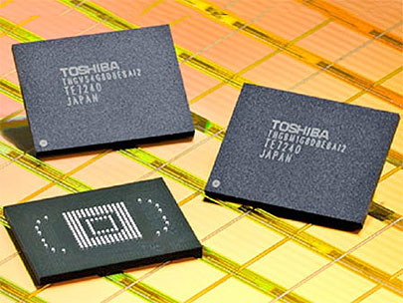

Slide 4
What is cairo?
cairo is an open source 2D graphics library with support for multiple output targets.
Written in C
Usually compiled as an external library (e.g. DLL)
Currently supported output targets include
X Window System (Linux)
Quartz (Mac)
Win32 (Windows)
image buffers (Targets an in-memory image buffer)
PostScript (Generates a PostScript file, suitable for high-quality print output)
PDF (Generates a vectorized PDF file, suitable for high-quality print output)
SVG file output (Generates a “Scalable Vector Graphics file)
Cincom created a Smalltalk language binding to the cairo C library
Utilizes Cincom’s “DLL and C Connect” technology
Published as a package called “CairoGraphics” in the Cincom public STORE
Notes:
Possible skip…

Slide 5
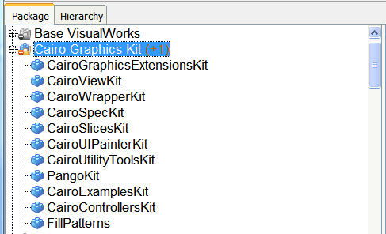
What is the CGK?
It’s a collection of packages that further enhance the CairoGraphics and Pango packages already provided by Cincom
It provides cairo based:
Views
Wrappers
Controllers
Extensions
Utilities
Examples
It’s a working example of what you can do with VisualWorks, cairo and Pango
It’s a free bundle licensed under LGPL for use in VisualWorks 7.7
An MIT license is also in the works
With a bit of work and some side effects, it also works in VW 7.4

Slide 6
CGK Origins…
What started it all?
The animation technique used by our older framework couldn’t meet the requirements of some new equipment that was being designed
The new system would require an animation to have two functions that VisualWorks couldn’t handle on its own
I would need to rotate a semi transparent PNG image in real time
I would need decent anti-aliasing after the image was rotated

Slide 7
CGK Origins…
What other requirements contributed to its evolution?
Other developers wanted to use cairo capabilities, but not at the binding level
Developers wanted to maintain a familiar VisualWorks experience
Use tools like UI Builder / Painter
WYSIWYG
Incorporate familiar functions from vector/pixel based editing programs
MVC
GUIs derived from ApplicationModel
I wanted to easily share my work with the VisualWorks community
Initially it started out as an example repository
www.mycairographics.com

Slide 8
Staying with the UI Painter
It let us break down the process of creating an animation overview into the same process as developing a normal VisualWorks GUI.
It provided the WYSIWYG functions they wanted
It had “some” of the features found in graphic editing tools I was familiar with so it was the logical place for my own tool creations.
New slices were needed to provided support for the various cairo based views
windowSpec

Slide 9
Staying with MVC
In the beginning, it was more like MV than MVC
CairoPNGImageView, PangoMarkupLabelView, and CairoLabeledVisualView don't have a runtime controller
CairoVisualRegion doesn't either, but it's not a really a View and has no model
CairoActionButtonView and CairoDendrogramView have controllers, but they don't exploit any specific behavior of cairo
Most work on controllers has revolved around extending / subclassing existing UIPainter controllers
I also include new trackers as part of the controller work

Slide 10
Staying with Wrappers ( a.k.a Decorators)
If the widgets were going to be VisualWorks “proper”, then they would need to work with most of the usual VisualWorks wrappers .
Some were extended and some were subclassed.
The wrapping process works in the same as a VisualWorks visual component
It’s part of the component spec and is done during UI building
Cairo based components interact with their wrappers more than their VisualWorks counterparts.
SpecWraper
TransformWrapper
LayoutWrapper

Slide 11
Cairo Based Views (CairoSimpleView)
Any cairo based view can always get to its spec wrapper
The spec hold the visual components DNA and in the CGK, I modify the DNA a lot.
Any cairo based view can always get to its transform wrapper.
The transform wrapper is an integral part of the CGK and gives most Views their ability to scale, rotate, translate etc…
Any cairo based view or subclass of VisualPart implements a “double dispatch” approach to the displayOn: method
Cairo based components may be handed an instance of ScreenGraphicsContext or CiaroContext and therefore, need to know how to render themselves on either context
Using the visual hierarchy browser is an example of when a component may get either type of context object
AOTA
Notes:
Screen cap for hierarchy browser

Slide 12
The Affine Transform and its role in the CGK
Its so important, it got its own wrapper
The transform wrapper is at the heart of the CGK
It provides a CGK View with a full range of transformation capabilities
A view can be rotated, scaled or translated either during runtime or during canvas editing
Transform wrappers also act as a composite container, allowing it to apply a single transform to multiple components
Transform wrappers can also be nested within each other.
Transform wrappers also understand how to translate Point objects in to or out of their coordinate space no matter how deeply nested.
globalToLocal:
localToGlobal:
Controllers that interact with transform wrappers don't need to worry about mouse point translation, the wrapper will take care of this form them
The transform wrapper maintains its own damage repair policy
CarrierArm

Slide 13
Conclusion
Copyright Lam Research Corporation

Slide 14
The Good and the Bad about cairo and the CGK
The Good
We’ve been able the achieve our goal of integrating more advanced graphics capabilities into our software while staying with VisualWorks
We can continue to use GUI development tools and methodologies we’re familiar with
Cairo has a fantastic community behind it. It is constantly evolving and continues to offer cutting edge features
The Bad
It’s a binding to the outside world. External DLL bindings make our developers nervous
Stay within the VM is usually our motto
The first sign of trouble with the VM usually involves me defending cairo
Most Smalltalk developers aren’t graphics guys. Looking pretty usually isn’t a high priority in Smalltalk
I respectfully disagree!
Using pre-built cairo binaries can tricky.
I ended up building my own for Win32.

Slide 15
What’s next for the CGK?
Views
VectorShape
CalloutBox
Gauge
Slider
Progress Bars
Radio Buttons
Graphing
Dendrogram
Line, Bar, Pie etc…
UI Painter Slices
Replacing the Color and Pattern Slice with a new Fill/Stroke slice
Color, Pattern, or Gradient selection in one unified slice
Whatever would be specific to the above Views
AppModelView
My answer to the difficulties of creating a VisualWorks “proper” widget.
Dendrogram

Slide 16
What would I like to see from Cincom
Just one thing
The UI Painter and its tools are starting to show their age! It’s time for an overhaul.
Simple…right?
Talk to me later, I have some ideas…..for a small fee of course ;-)
Ok, maybe one more thing
Can you fix this kind of stuff?
ScrollerButtonView
outerContainer
^self container notNil
ifTrue: [self container container notNil
ifTrue: [self container container container notNil
ifTrue: [self container container container container notNil
ifTrue: [self container container container container container]]]]

Slide 18
Supplemental Slides
Copyright Lam Research Corporation

Slide 19
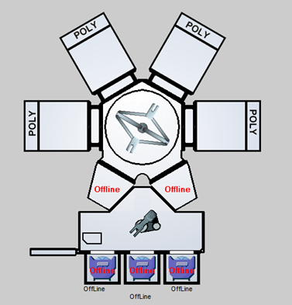
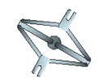
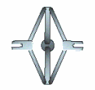
Animation The Old Way
Images are added or removed from a CompositePart at runtime
All possible images reside in a Dictionary that’s maintained by the application model
Events drive the animation
The sequence below would animate an arm extension, retraction and rotation event sequence
Image 1
Image 2
Image 3
Image 4
replaced by
replaced by
replaced by

Slide 20
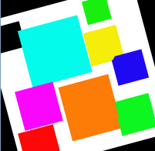
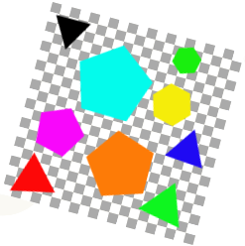
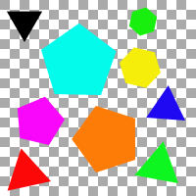
Dealing with PNG Files…VisualWorks versus cairo
Test PNG Image
VisualWorks (7.4)
The result after the PNGImageReader reads the file.
The result after a 15 degree rotation.
cairo
The result after using cairo to render the image
Using a cairo affine transform
to rotate the image

