Slide 1

SMALLTALK-DRIVEN
GUI TESTING
By Andreas Hiltner

Slide 2


Slide 3
Overview
Intention
Record and Replay Events
Script Classes
  Screenshot
  SendInput
  OSWindow
Script Example
Questions

Slide 4
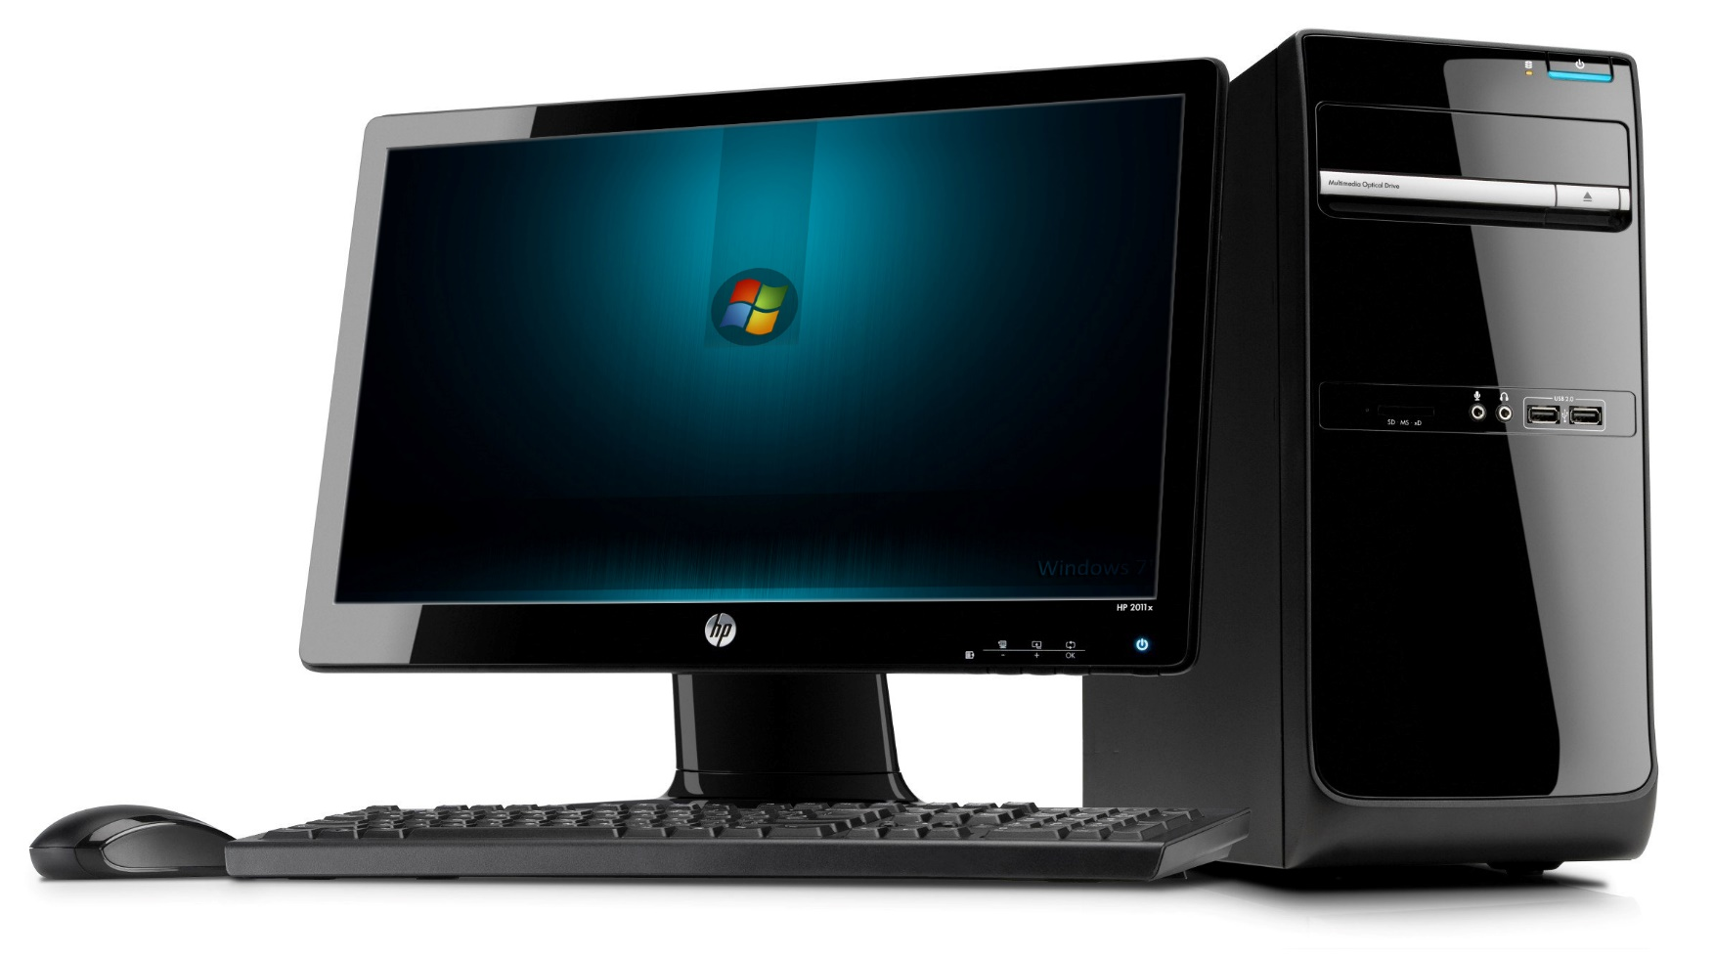
INTENTION
To develop a GUI-Testing framework, that can not only test Smalltalk internal GUI, but external processes as well.
It should be usable within SUnit tests.
Notes:
Why brand is important

Slide 5
Record and Replay Events
Record all events (keyboard, mouse) with timing.
Events can be saved to a file and replayed later.
Beware of applications, that save the state in between, e.g. Calculator

Slide 6
Record and Replay Events
Advantage:
  What-You-See-Is-What-You-Get
Drawback:
  Uses absolute coordinates
  Recording has to be redone, if the test changes even the slightest bit

Slide 7
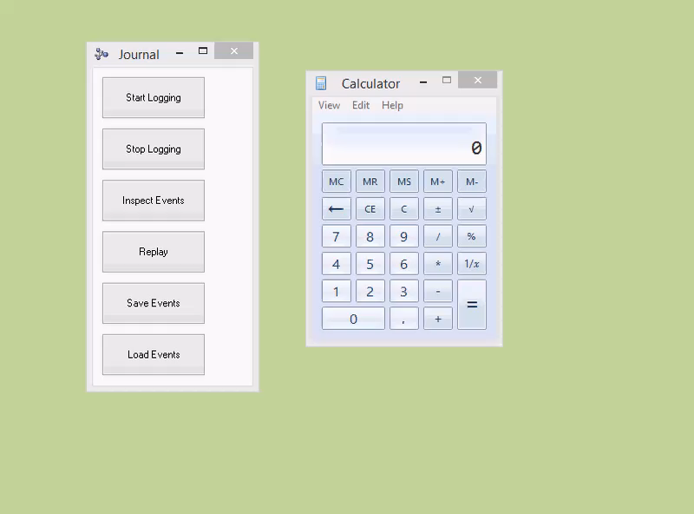
Record and Replay Events

Slide 8
Script
Windows
Mouse Input
Keyboard Input
Screenshot

Slide 9
Script - Window
Retrieve Window with Title
Wait for Window with Title
Retrieve Window at a certain location
Get the (Windows) menu
Send a menu item event
Retrieve Titlebar-Information
  (location of Minimize/Maximize/Close button)

Slide 10
Script – Mouse Input
Click left/middle/right button
Scroll Mouse wheel up/down
Move cursor
Hover

Slide 11
Script – Keyboard Input
Send String or individual Characters
Send Shortcut (e.g. CTRL+C, ALT+1)
Send Keys like LeftArrow, RightArrow, PageUp, PageDown, Return, etc.

Slide 12
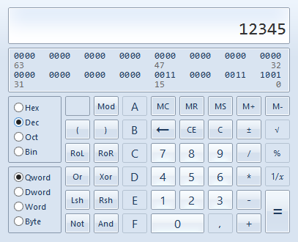
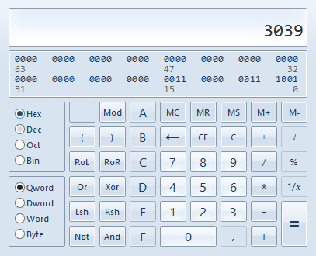
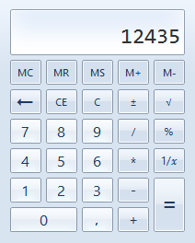
Script – Class Screenshot
Take screenshot with / without window frame
Save screenshot as Bitmap / PNG / JPEG

Slide 13

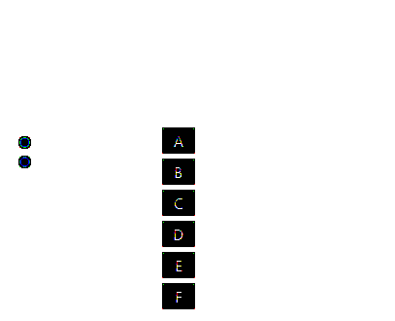
Script – Class Screenshot (con’t)
Compare Screenshot with existing Bitmap
Save differences to a Bitmap in a file

Slide 14
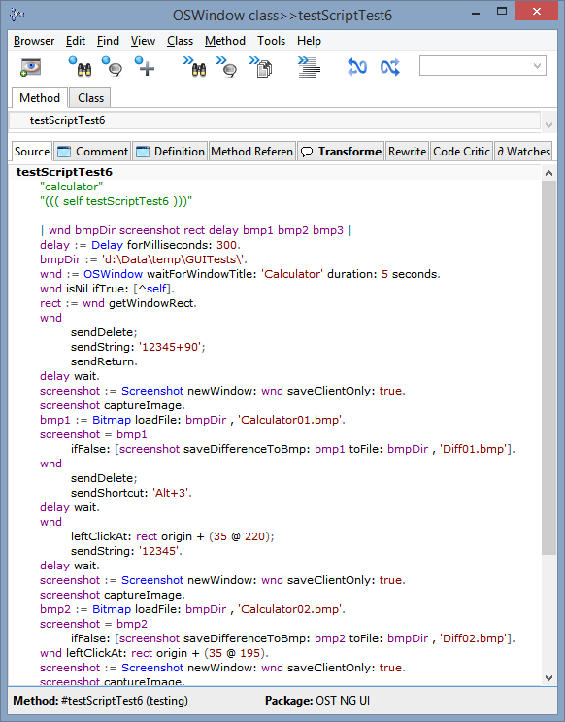
Script

Slide 15
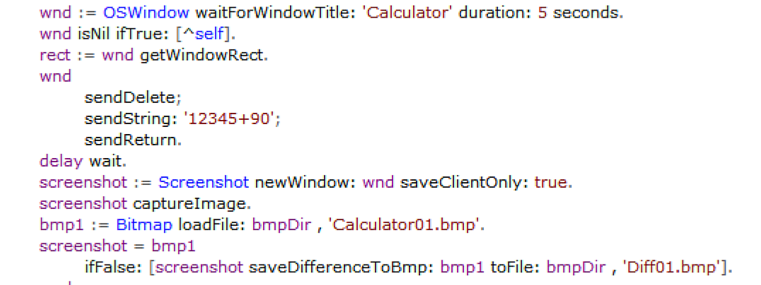
Script – Part One

Slide 16
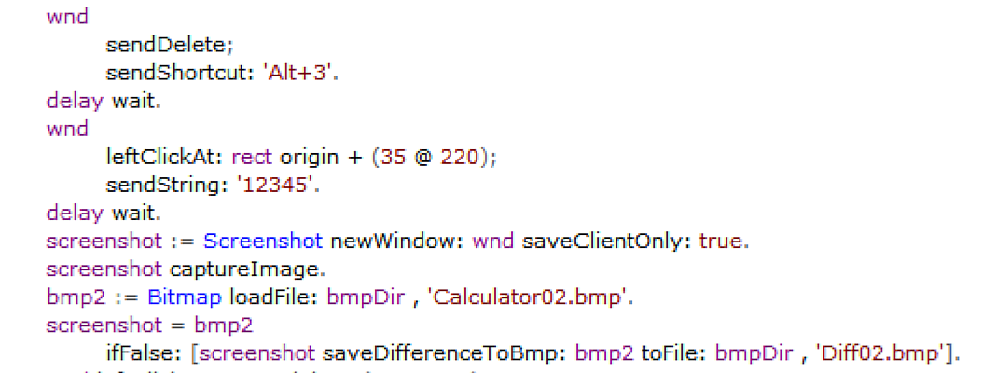
Script – Part Two

Slide 17
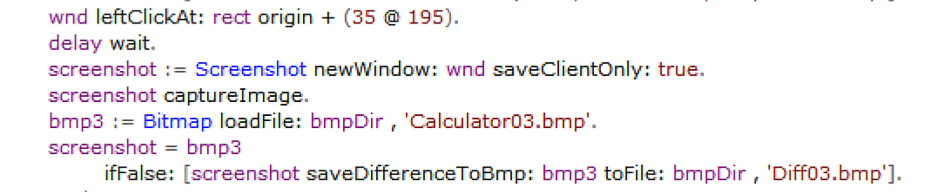
Script – Part Three

Slide 18
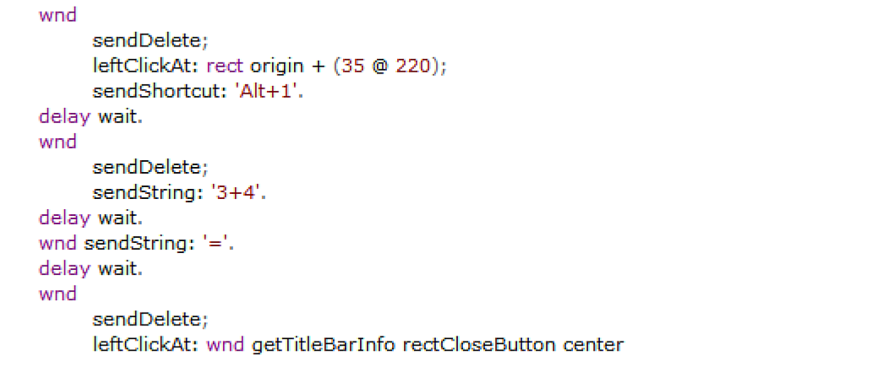
Script – Part Four

Slide 19
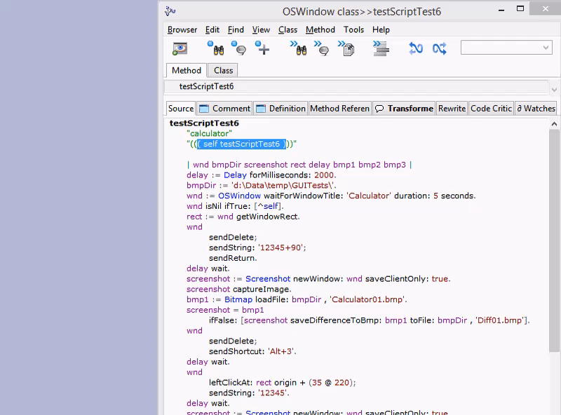
Script – Video

Slide 20
Questions?

Slide 21
Contact Information
Star Team (Smalltalk Strategic Resources)
  Suzanne Fortman (sfortman@cincom.com)
Cincom Smalltalk Program Director
  Arden Thomas (athomas@cincom.com)
Cincom Smalltalk Product Manager
  Jeremy Jordan (jjordan@cincom.com)
  Cincom Smalltalk Marketing Manager
  Suzanne Fortman (sfortman@cincom.com)
Cincom Smalltalk Engineering Manager

Slide 22
Try Cincom Smalltalk
Evaluate Cincom Smalltalk:
try.cincomsmalltalk.com
Join our Cincom Smalltalk Developer Program:
develop.cincomsmalltalk.com

