Slide 1
Cruiser:
A Tool to Package Pharo Applications
Vincent BLONDEAU
9/11/2018

Slide 2
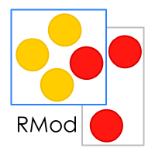



Who I am
PhD: Test Selection Practices in a Large IT Company
Post doc @ Lam Research:
  Full stack team (Chris Thorgrimsson)

Slide 3
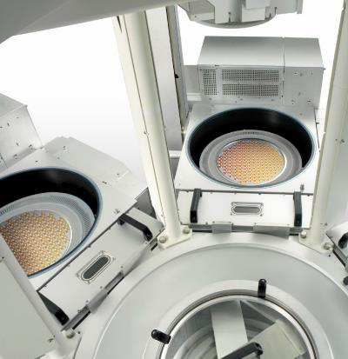
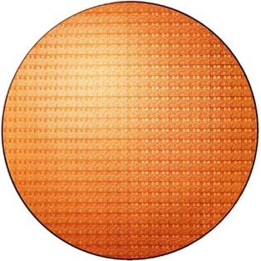
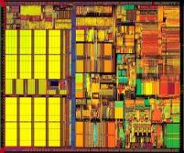
All Begins with….
The Product
300 mm Wafer
Single Chip
Source: Intel Museum
Notes:
1/27/16:
Updated TEM graphic
Source: Chipworks teardown report on Intel 14 nm Broadwell (Dec’14)
7/1/15:
New slide

Slide 4
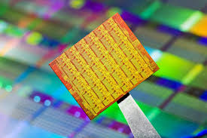
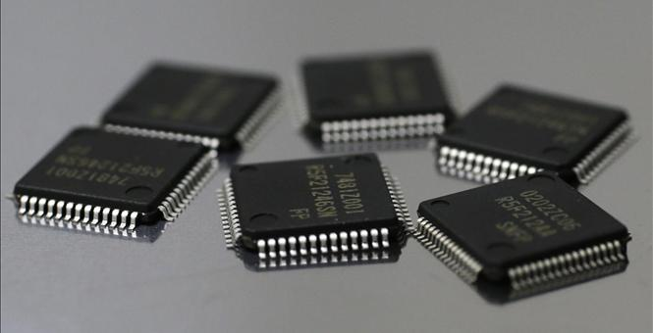
Which Get Turned Into…

Slide 5
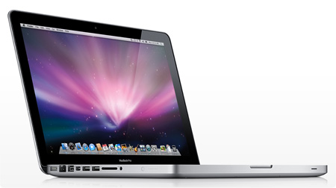
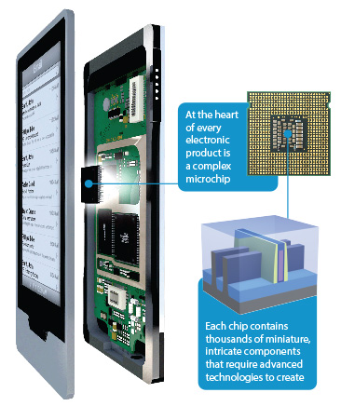
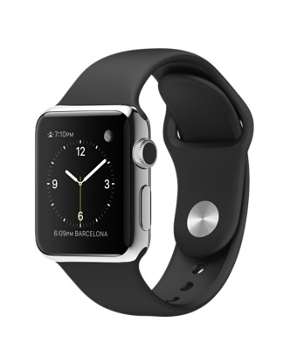
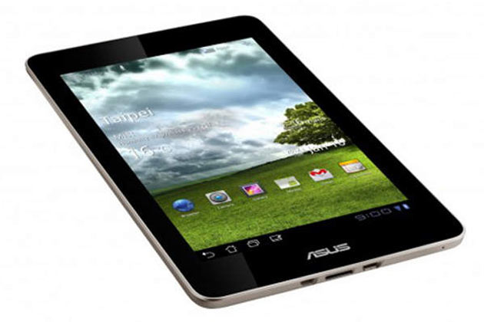
And Go Into Things Like This…

Slide 6
What my Team Does
We write the software that runs the machines
We are responsible for infrastructure
  Operational infrastructure
    The core set of code/libraries/frameworks that run the machines
  Tooling infrastructure
    Tools for the developers
    CI: Jenkins
    SCM: Store, Git
    Test: Sunit, ATAC
  Smalltalk
  C/C++/C#
  Java
  JavaScript

Slide 7
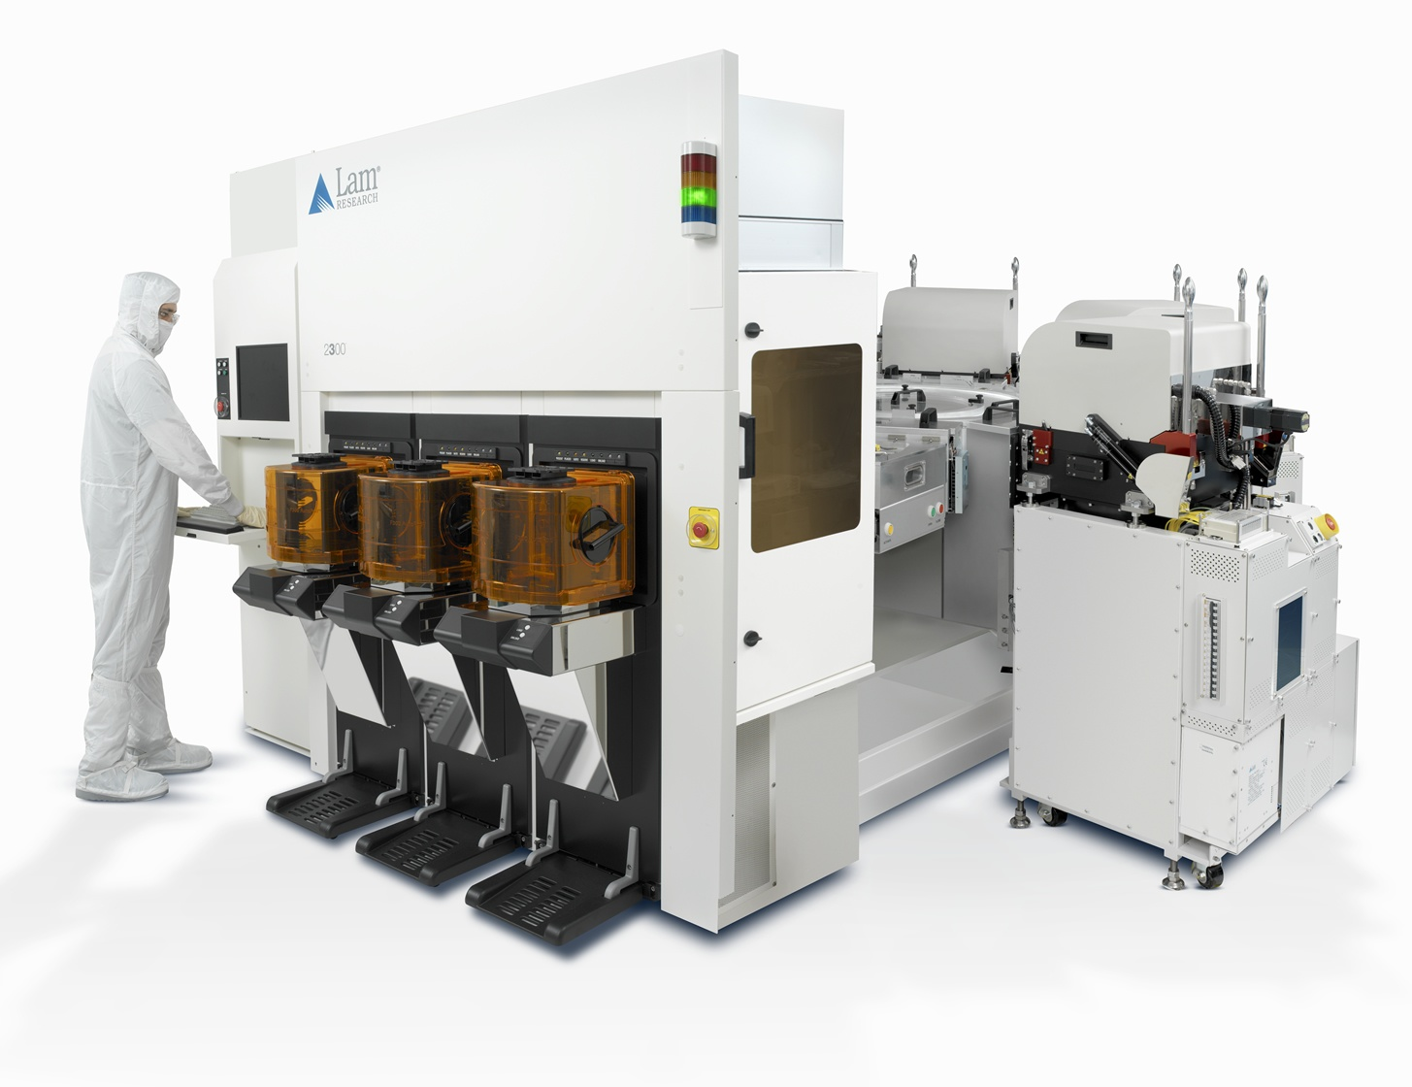

An Example Machine
Notes:
Multiple images
Multiple processes
1+ million LOCs
Legacy system

Slide 8
Lam Research does not use Pharo so why Pharo?
It is currently the leading Smalltalk “idea incubator”
  If we like what we see, we will invest in porting
Adopted by the Smalltalk academic & research community
  Engagement with the academic community is vital
  I am with Lam because of this engagement
Pharo embraces opensource
  If we commit to backing work in Pharo (or Squeak) we will commit to making that work open
    Roassal
    IntelSoft
    GraphQL
    ObjectChanges
    Snowglobe

Slide 9
A First Thing to do
Idea
Executable
Packaging tool:
  Where configurating and adding new features is easy
  With the good Virtual Machine
  Without writing to the file system
  Without access to developers tools
Cruiser

Slide 10


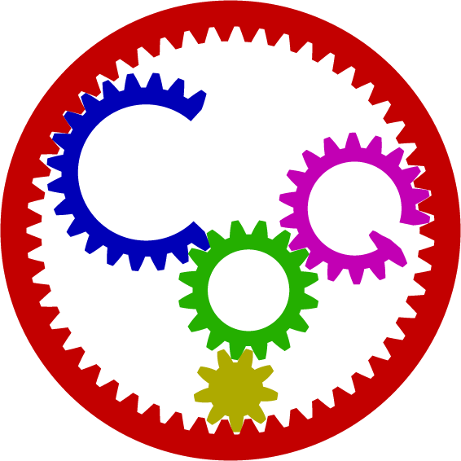
What does that do?

Slide 11
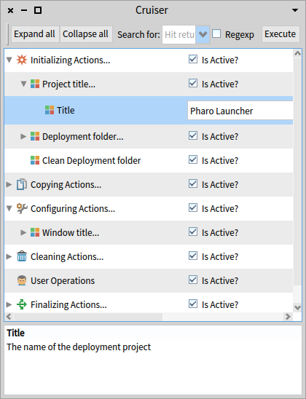
How it Works
List of actions for the packaging
Actions grouped by topic:
  Initialization
  Copy
  Configure
  Cleaning Actions
  User operations
  Finalizing
Based on the settings engine
  Pragmas: no strong coupling
  Actions are easy to create

Slide 12
How to use it?
Repository: https://github.com/VincentBlondeau/Cruiser
Tested and working with
  Windows
  Pharo 7.0 (Beta)

Slide 13
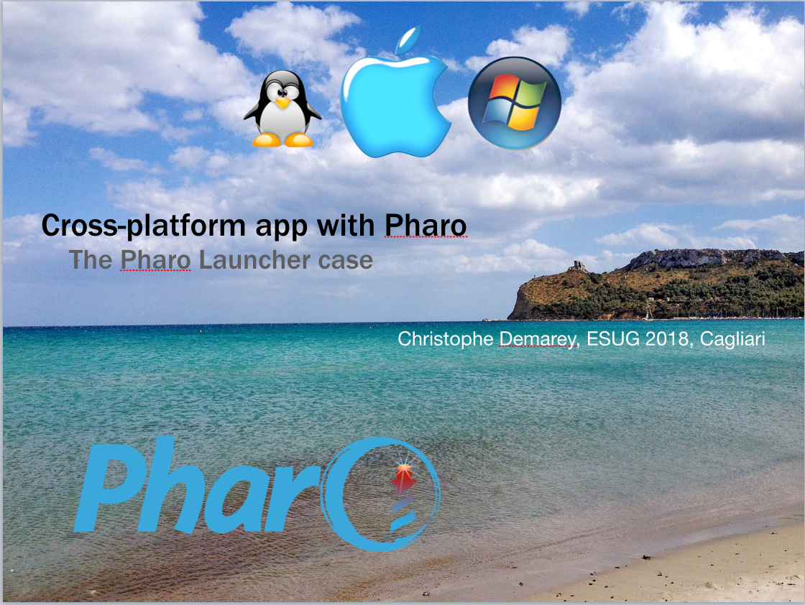
An Example with the Pharo Launcher
Thursday, 3:30pm

Slide 14
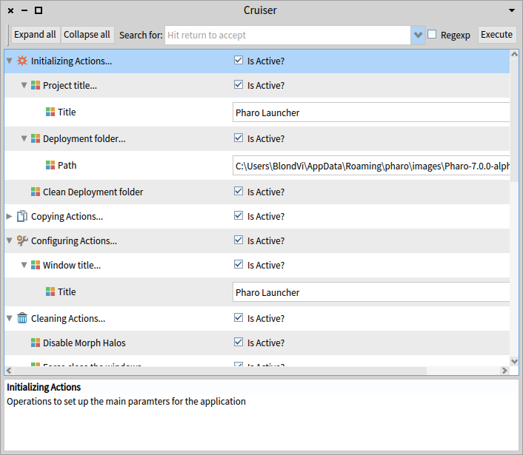
Conclusion
Cruiser
  Package Pharo applications
    No write access
    No developer tools
  Highly configurable
  Fast deployment

Slide 15
Future Work
Integration inside the Pharo Launcher
Support other platforms
Solve new bugs due to the evolution of Pharo 7
Avoid to use ProcessWrapper DLL
  Implies no-blocking FFI multi-threading
Add new features
  Loading baseline and configurations
  Copy Resources
  Other ideas?

Slide 16
Summary
  https://github.com/
  VincentBlondeau/
  Cruiser

