Slide 1
Websockets for fencing scores
Annick Fron
https://fencingfox.com

Slide 2
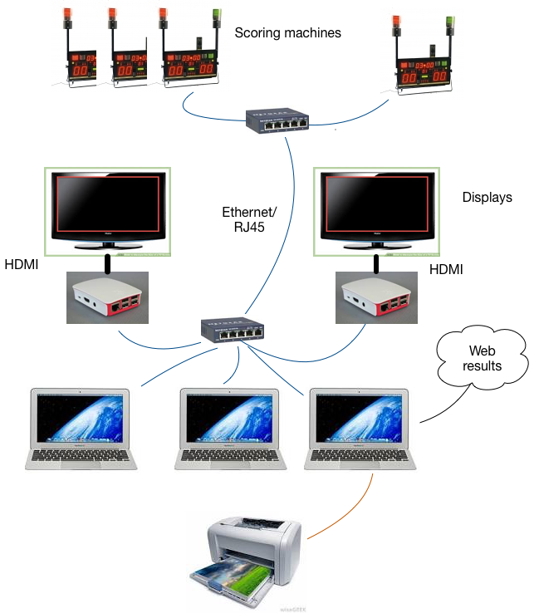
aRCHITECTURE for a fencing competition
Web sockets

Slide 3
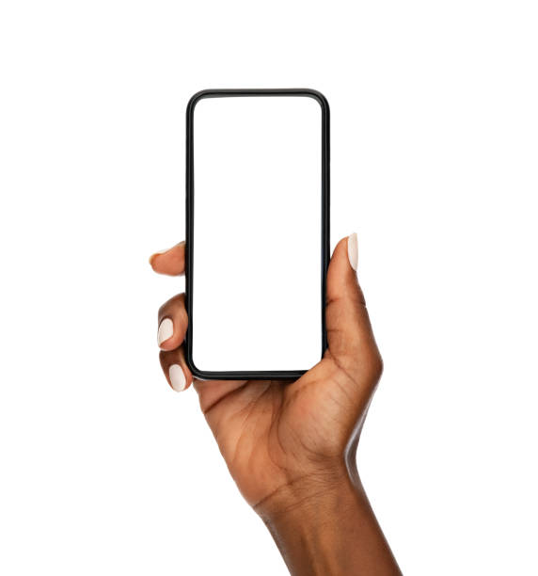
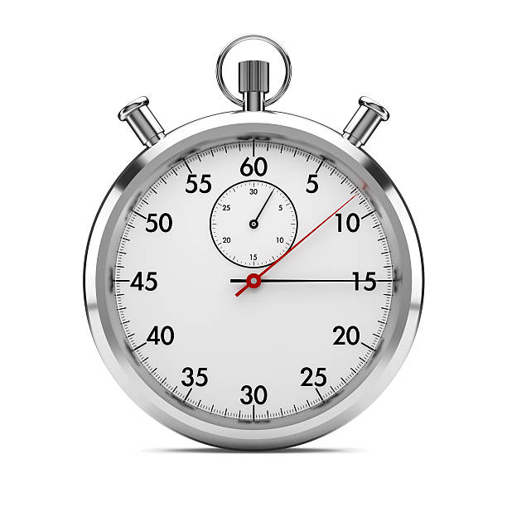
Path hops
Arena
Server

Slide 4
Display of the chronometer from arena on a mobile phone over Internet
https://fencingfox.com/videos/orange.mov
https://fencingfox.com/videos/dixiemeSecondePhotos.mov
https://fencingfox.com/videos/AffichagePiste.mov

